Slide 1

Electric Water Heater
Graduation project
TEAM MEMEBERS
Abdulrahman Anane Yousef
Abdulrahman Ahmed Elfaramawi

Slide 2
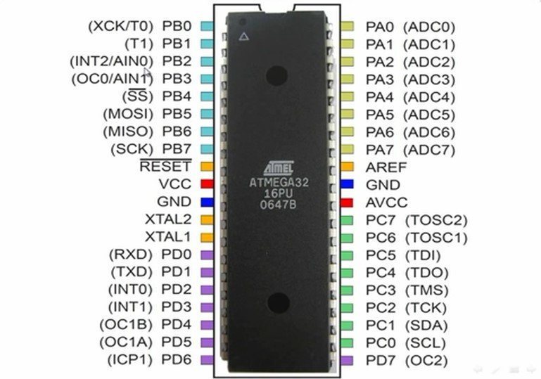
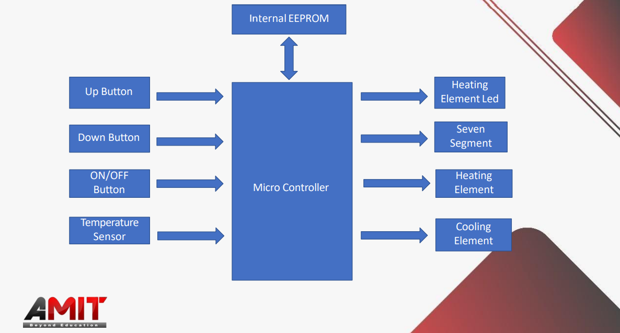
Our micro-controller
What are we supposed to build :
ATMEGA 32

Slide 3
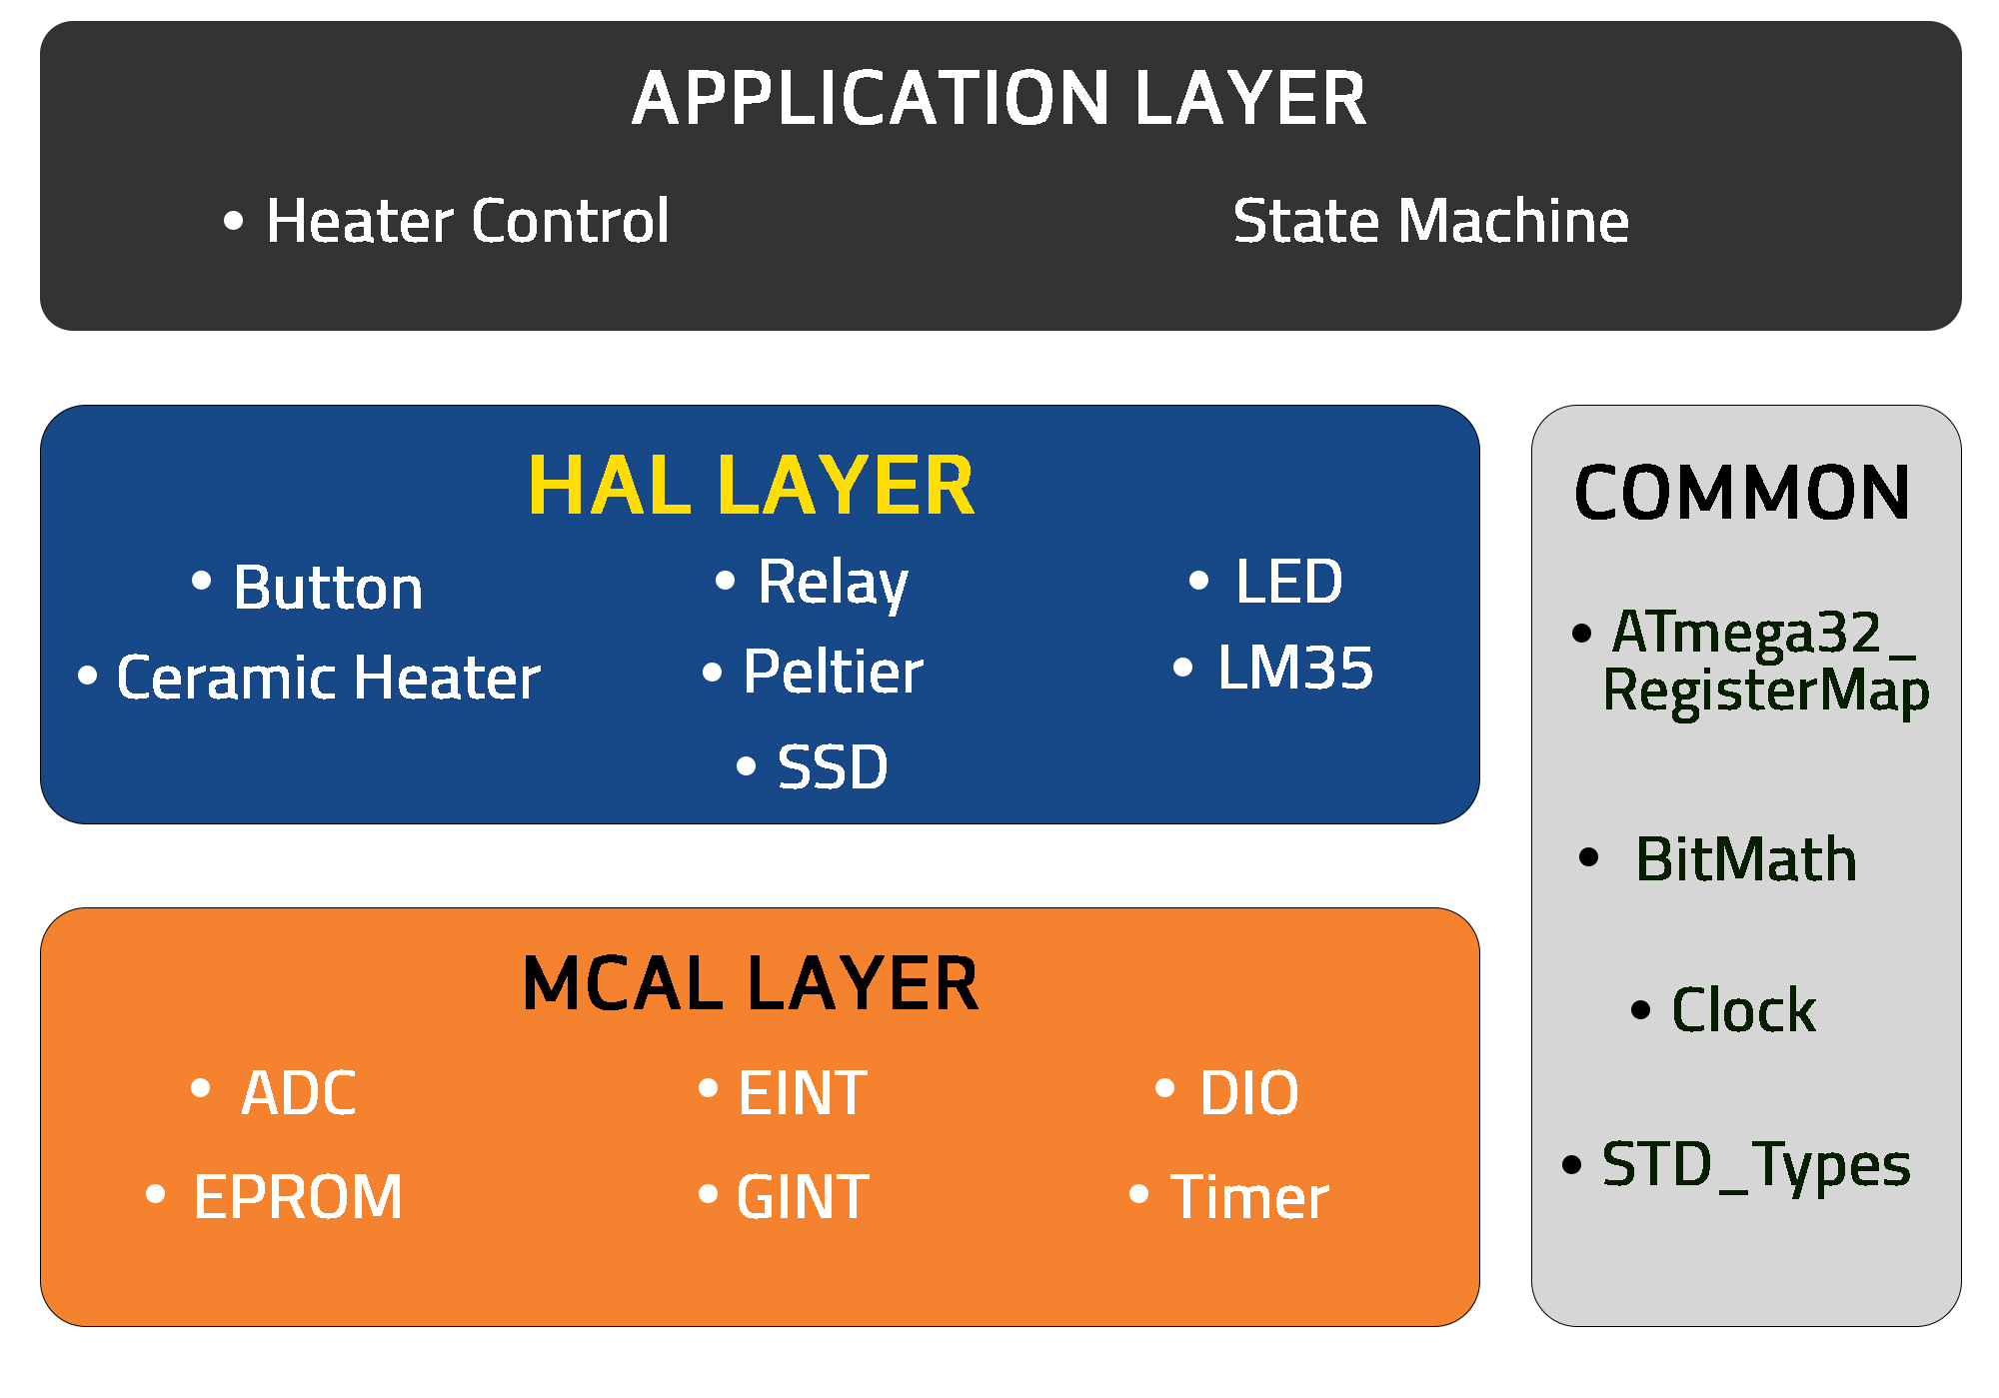
LAYERED
ARCHITECTURE

Slide 4
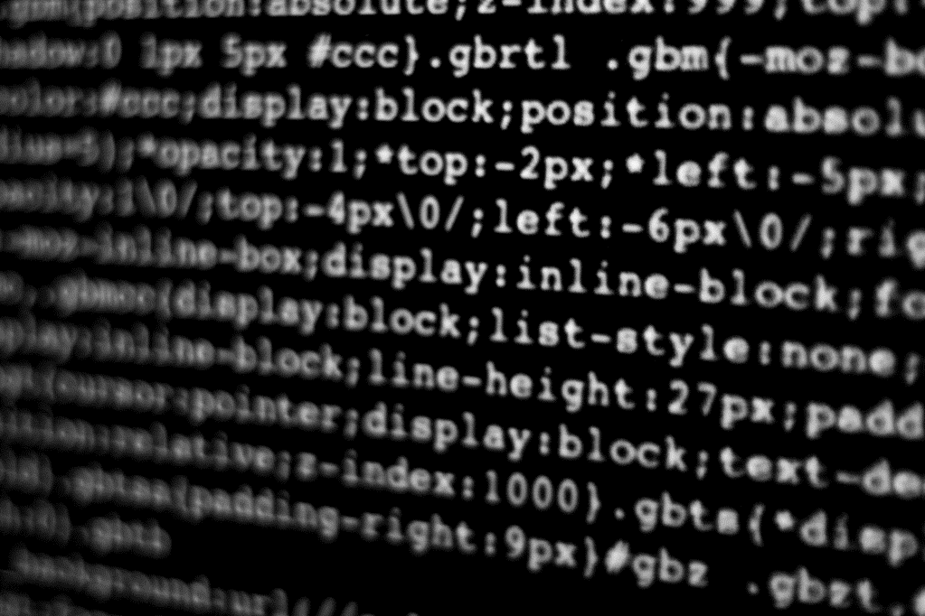
BUILDING THE PROJECT
Let’s Dive In

Slide 5
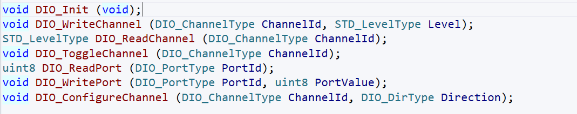
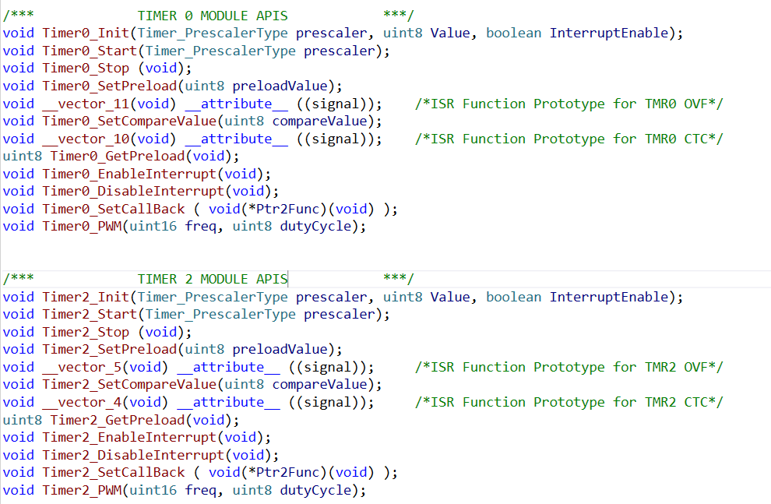


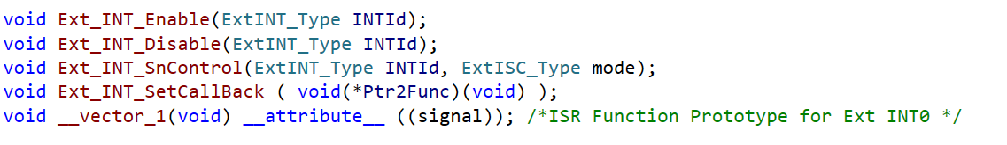

Microcontroller abstraction layer
DIO: • Timer:
ADC:
EEPROM: • GINT:
• EINT:
GINT:

Slide 6


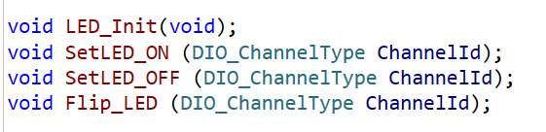


HARDWARE abstraction layer
Button: LM35:
LED: Ceramic Heater:
SSD: Peltier:
Relay:

Slide 7

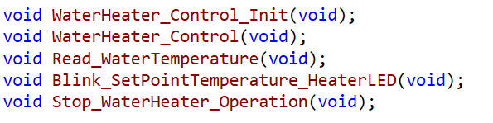
application layer
STATE MACHINE:
WATER HEATER CONTROL:

Slide 8
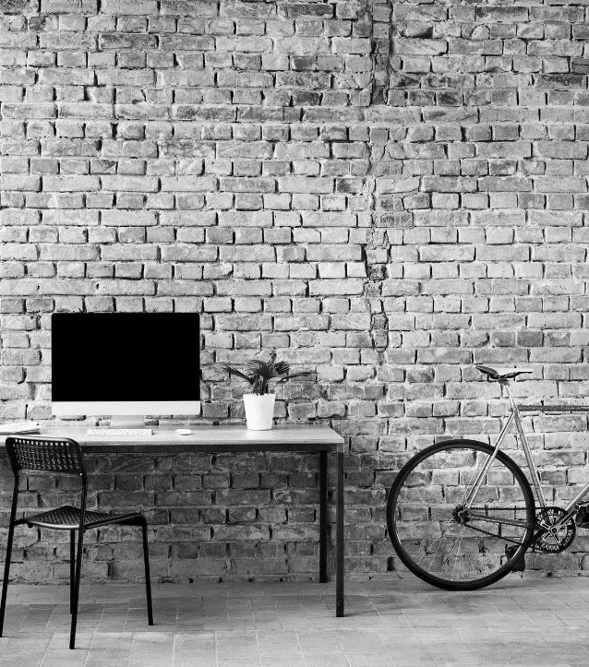
Simulation using proteus

Slide 9
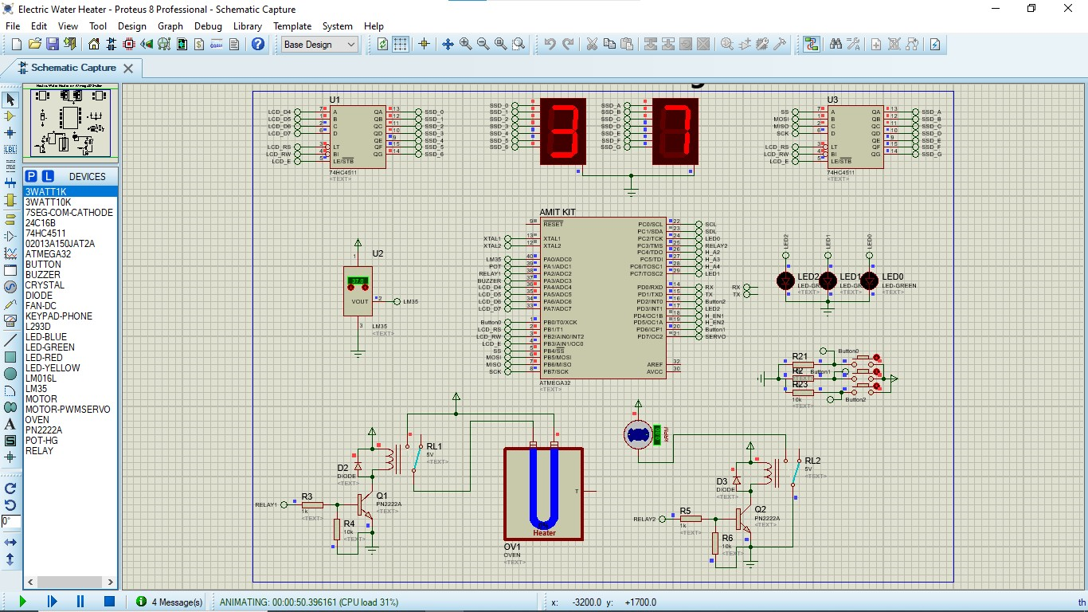

Slide 10
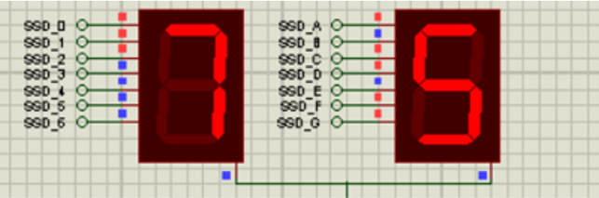
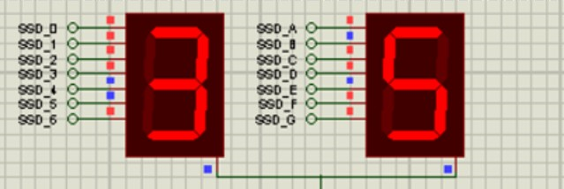
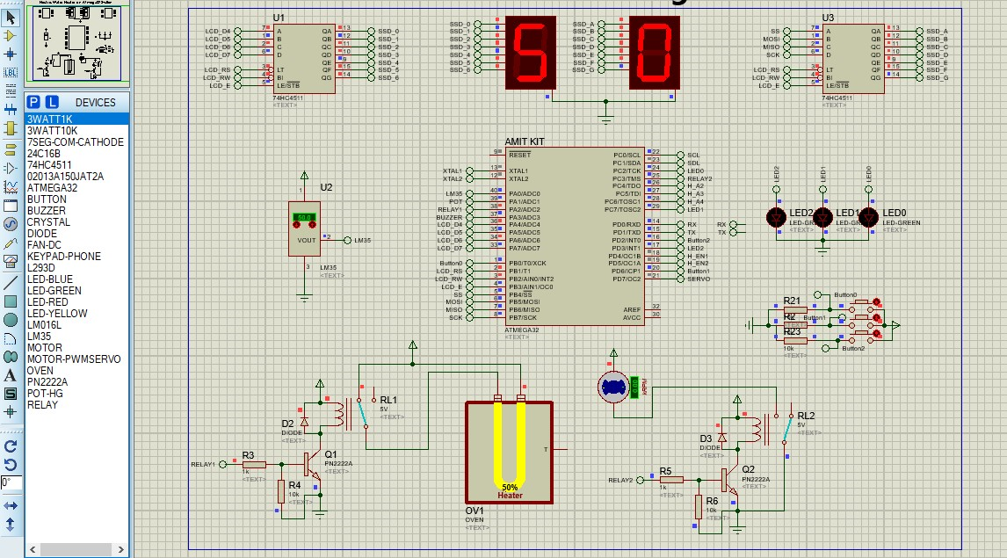

Slide 11



THANK YOU
Abdulrahman Anane Yousef
Abdulrahman Ahmed Elfaramawi
01090430445
Body.anane2010
@gmail.com
01002510469
Abdulrahman.elfaramawi
@gmail.com

